Slide 1

Museums and Digital Technology: Idealism and Pragmatism
Susana Smith Bautista, Ph.D.
November 6, 2014

Slide 2
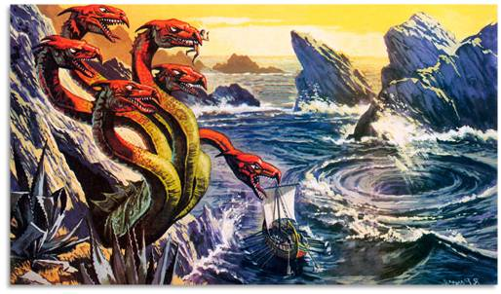
“Between Scylla and Charybdis” “Between a rock and a hard place”
tracksofrevolution
Museums & Digital Technology: Idealism & Pragmatism. Susana Smith Bautista, Ph.D.

Slide 3

PRAGMATISM
IDEALISM
tracksofrevolution
Museums & Digital Technology: Idealism & Pragmatism. Susana Smith Bautista, Ph.D.

Slide 4
PRAGMATISM
WHY:
WHY NOT:
There is no budget for digital projects
None of the staff has any digital skills
There are other priorities
We have a website, that’s enough
Technology today affects every single aspect of the institution, which can offer a way to understand new staffing skills and new funding opportunities.
Museums & Digital Technology: Idealism & Pragmatism. Susana Smith Bautista, Ph.D.

Slide 5
IDEALISM
WHY:
WHY NOT:
To please boards, funders, politicians
To appear modern and trendy
Because everyone else is doing it
We need to reach younger audiences
Embarking on costly new projects without fully understanding how they fit your institutional goals, resources, and culture.
Museums & Digital Technology: Idealism & Pragmatism. Susana Smith Bautista, Ph.D.

Slide 6
IDEALISM
PRAGMATISM
Where is your museum?
Museums & Digital Technology: Idealism & Pragmatism. Susana Smith Bautista, Ph.D.

Slide 7
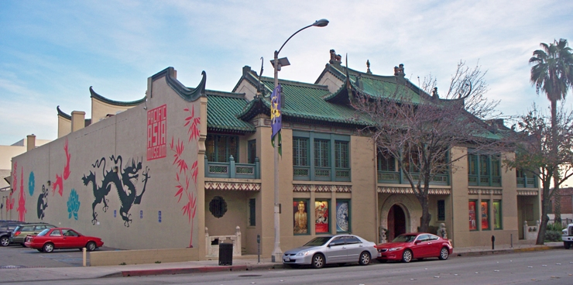

Museums & Digital Technology: Idealism & Pragmatism. Susana Smith Bautista, Ph.D.

Slide 8

The Field Museum - Digital Learning Manager (July 2012)
Minneapolis Institute of Arts – Web Developers, part of Media & Technology team in the Interactive Media Department (July 2012)
The J. Paul Getty Museum – Education Technologist (August 2012)
Peabody Essex Museum – Associate Director of Integrated Media (October 2012)
The Walters Art Museum – Online Content Specialist (October 2012)
The Henry Ford Museum – Curator, Communications & Information Technology (November 2012)
Museums & Digital Technology: Idealism & Pragmatism. Susana Smith Bautista, Ph.D.

Slide 9
Assistant Director, Interpretation and Research - Museum of Modern Art, New York
Works with the director of Interpretation and Research to lead the interpretive planning process with curators for MoMA’s collection and approximately 30 special exhibitions annually, with the goal of ensuring content is accessible to non-art-specialist audiences. Works collaboratively to develop engaging, innovative, and accessible interpretive resources and experiences (both analog and digital) including interpretive texts; audio tours for adults, kids, and visitors with visual impairments; mobile interpretive content and strategy; games and play-based learning resources; participatory learning spaces in the galleries; content for MoMA website; and other digital learning platforms and initiatives. Oversees the Emily Fisher Landau Education fellow and visitor research initiatives and qualitative evaluation of educational programs and interpretive resources. Works with Digital Media to make interpretive resources available on MoMA.org, MoMA Audio+, MoMA App, MoMA Learning, and other digital platforms.
Requirements: Master’s degree in art history, museum studies, museum education, or related field. Minimum of eight years experience working in a museum setting. In-depth knowledge of modern and contemporary art. Strong writing skills and the ability to write for different audiences and platforms. Demonstrated knowledge of current museum education, interpretation, and visitor research, and evaluation practices and theory. Familiarity with media production. Experience with mobile and Web technologies and game development will distinguish applications. Supervisory experience preferred. The assistant director must have demonstrated experience and willingness to innovate and experiment with new modes of visitor engagement with modern and contemporary art—both in the Museum and on an increasing number of digital platforms.
Museums & Digital Technology: Idealism & Pragmatism. Susana Smith Bautista, Ph.D.

Slide 10
Vice President, Technology - Carnegie Museums of Pittsburgh
Carnegie Museums of Pittsburgh seeks a Vice President of Technology to serve as member of the organization's senior leadership team and provide strategic leadership for technology operations, data/content management, digital delivery channels, and applications support for its four museums-Carnegie Museum of Art, Carnegie Museum of Natural History, Carnegie Science Center, and The Andy Warhol Museum-as well as central service functions. Working closely with the staff from the museums and central departments, the VP develops the vision and directs the development and implementation of forward-looking, holistic, and sustainable technology solutions to achieve the museum's and overall organization's missions and improve cost effectiveness and service quality.
The department currently services approximately 650 users and several thousand network devices and provides platforms for engaging 1 million onsite visitors, 2.3 million unique visitors to the museums' websites, and 600,000 users of mobile offerings annually.
Museums & Digital Technology: Idealism & Pragmatism. Susana Smith Bautista, Ph.D.

Slide 11
Associate Director of Interactive Technology - Philadelphia Museum of Art
As part of a major reorganization of the museum’s technology functions, the Philadelphia Museum of Art has created a new position of Director of Interactive Technology. This is an endowed position that will play a key role in the museum’s five year strategic plan. Under the leadership of the Director of Information and Interpretive Technology and in collaboration with management across the Museum, the Associate Director for Interactive Technology creates and manages interactive strategies to broaden access to the permanent collection and special exhibitions. These strategies will enhance the Museum’s ability to engage existing audiences more effectively, develop new audiences, build greater awareness of the Museum in the community as a cultural and educational resource, and strengthen its brand both nationally and internationally. The Associate Director for Interactive Technology is responsible for planning and implementing a broad range of projects, working closely with the Division of Marketing and Communications, curatorial departments, and the Division of Education as the primary resources for content and information about visitors and their learning preferences. Among these projects are the ongoing development and enhancement of the Museum’s website, the creation of new mobile applications, and the design of interpretive tools to facilitate broader access to and greater understanding of the collection and special exhibitions. The Associate Director for Interactive Technology should be experienced in the development and implementation of digital strategies in cultural and educational institutions and have an extensive background in online engagement, interactive design, and digital communications. Managing a team of creative professionals, this role is also responsible for staffing, project management, and budgeting.
Museums & Digital Technology: Idealism & Pragmatism. Susana Smith Bautista, Ph.D.

Slide 12
Director of Digital Media - The Balboa Park Online Collaborative
This position will manage a diverse range of digital projects, delivered to websites, kiosks and mobile, that improve public access to the rich content found in Balboa Park’s museums, including subjects such as History, Art, Science, Transportation, and is responsible for all aspects of management, coordination, and implementation of digital projects from research, planning, content production, through quality assurance and evaluation.
Skills Needed:
Project management skills in scoping, identifying risks, scheduling and planning of digital projects; experience with Agile-based project management methodologies.
Organizational skills to manage competing priorities and expectations and timely delivery of projects
A passion and broad knowledge of digital media including audio-video tours, in-gallery interactives, touch interactives, websites etc.
Solid working knowledge of web and mobile technologies; knowledge and experience with Drupal CMS platform, MySQL, PHP, jQuery, JSON and HTML/CSS preferred.
Strong verbal and written communication skills, effective presentation skills.
Ability to translate complex technical ideas into understandable solutions to a non-technologist and an ability to interact effectively and diplomatically with a variety of internal and external people.
Problem solving ability to recognize issues and identify solutions
Excellent people management skills
Evaluation skills to assess project risks and conduct user evaluations
Maintain a culture of ongoing learning
Budget and financial experience
Museums & Digital Technology: Idealism & Pragmatism. Susana Smith Bautista, Ph.D.

Slide 13
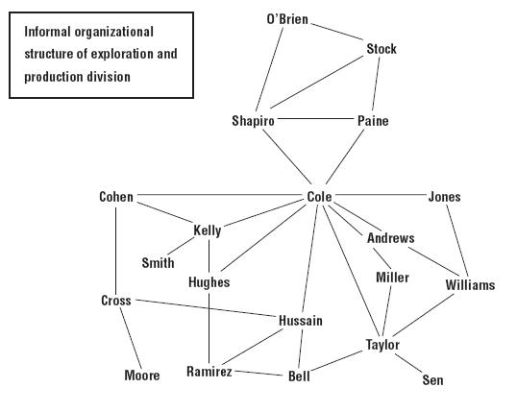
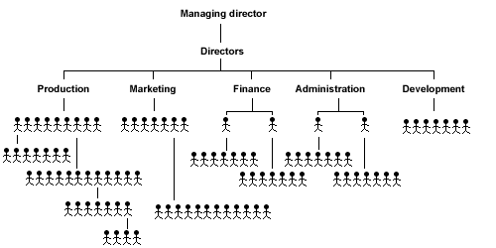
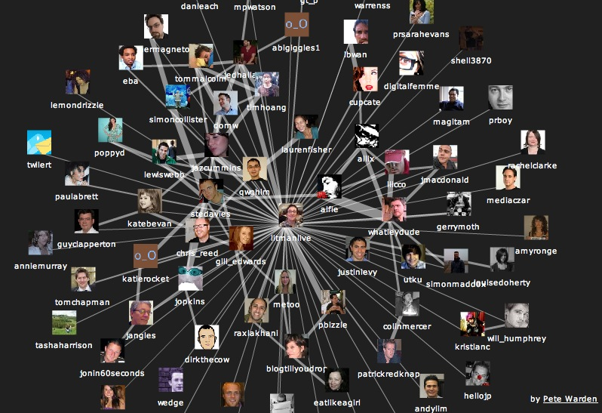
www.workinfo.com
www.gregglee.biz
DISTRIBUTED WORKFLOW
Museums & Digital Technology: Idealism & Pragmatism. Susana Smith Bautista, Ph.D.

Slide 14
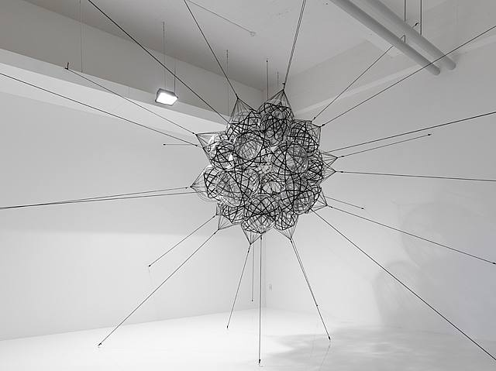
“The museum’s challenge, and indeed its authority in
the digital age, comes not only from a sense of accumulated expertise, but also from its ability to seamlessly navigate contradictory spaces and practices within this
distributed learning network.”
Tomas Saraceno, 2009
Museums & Digital Technology: Idealism & Pragmatism. Susana Smith Bautista, Ph.D.

Slide 15
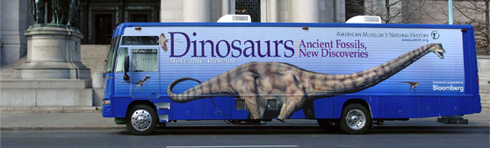
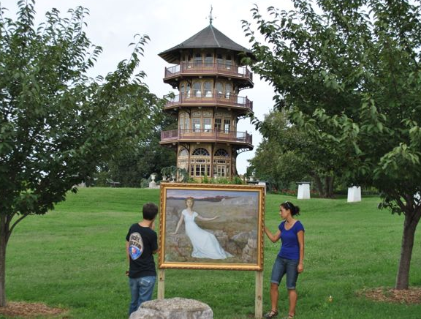
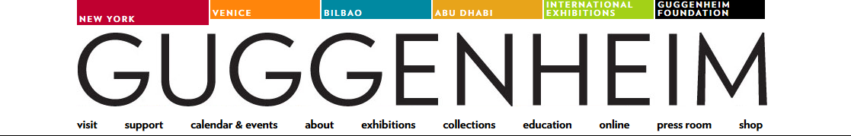
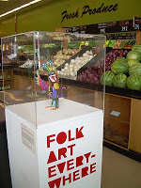
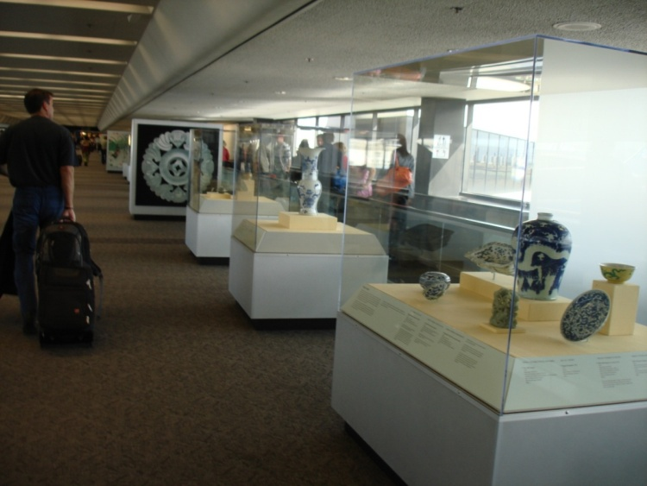
Moveable Museum Program, American Museum of Natural History
Scott Burkholder
Off the Wall, Walters Museum
THE DISTRIBUTED MUSEUM
Folk and Craft Art Museum, Los Angeles
Asian Art Museum at SFO Airport
Museums & Digital Technology: Idealism & Pragmatism. Susana Smith Bautista, Ph.D.

Slide 16
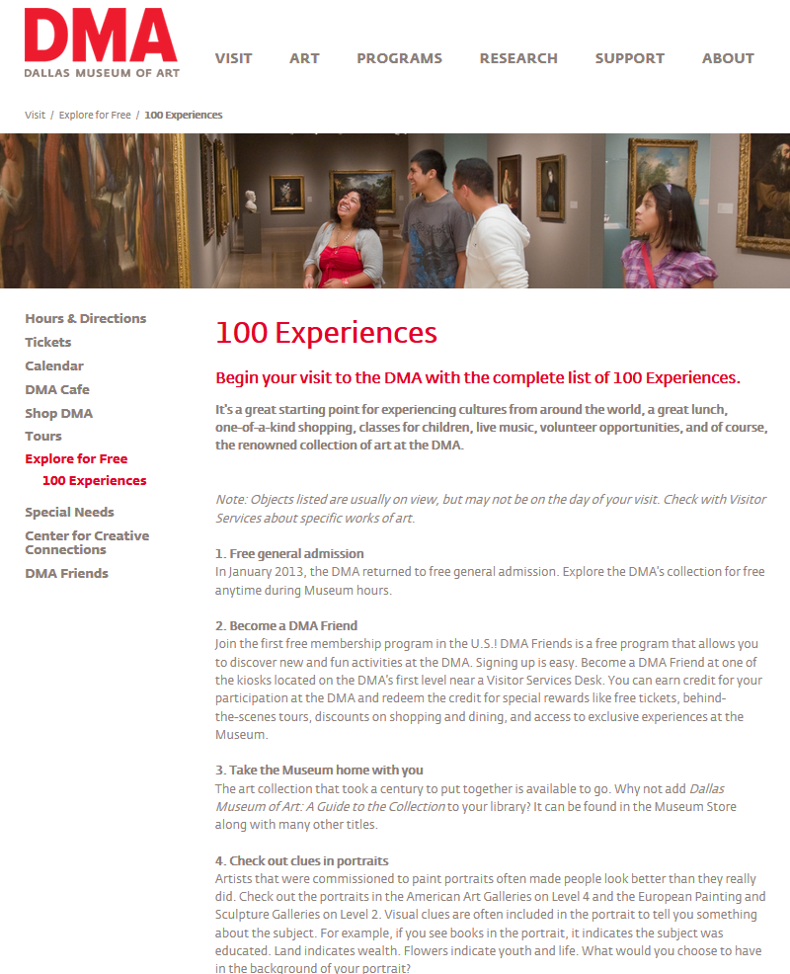
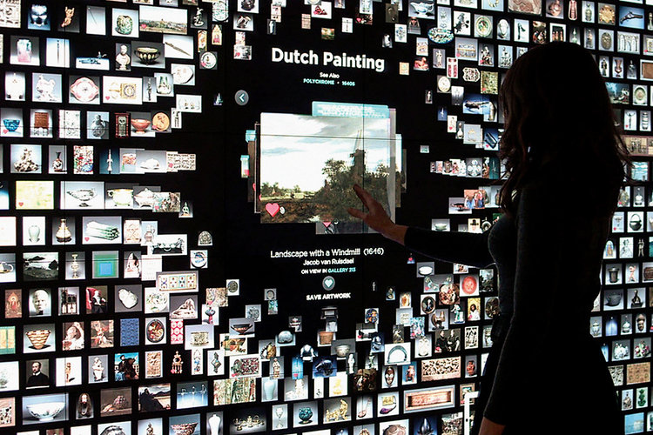
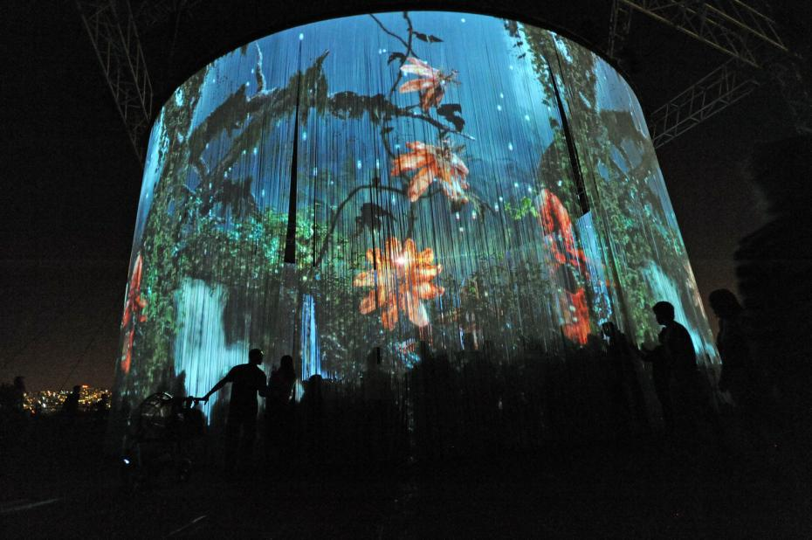
THE MUSEUM EXPERIENCE
www.idiom.co
www.upi.com
Museums & Digital Technology: Idealism & Pragmatism. Susana Smith Bautista, Ph.D.

Slide 17
PHYSICAL
FIXED
LOCAL
CLOSED
VIRTUAL
MOBILE
GLOBAL
OPEN
Museums & Digital Technology: Idealism & Pragmatism. Susana Smith Bautista, Ph.D.

Slide 18
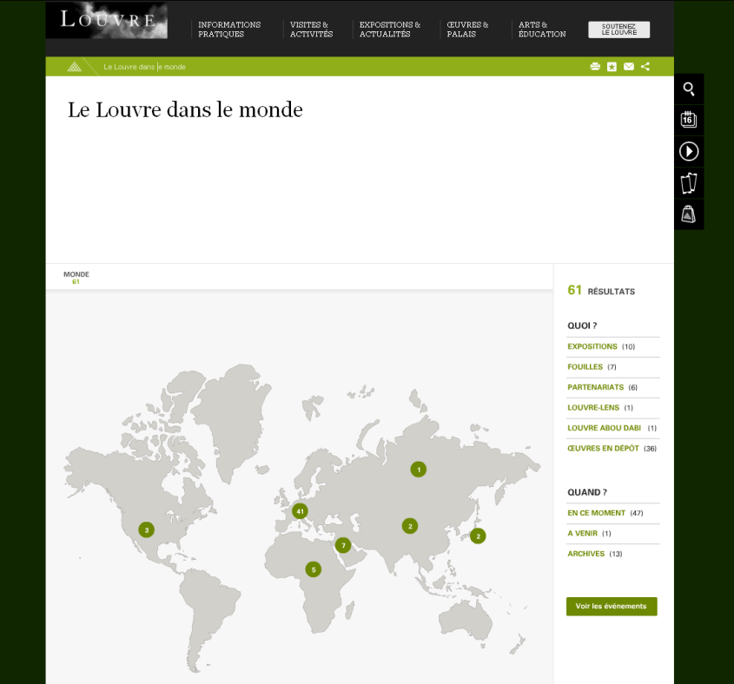
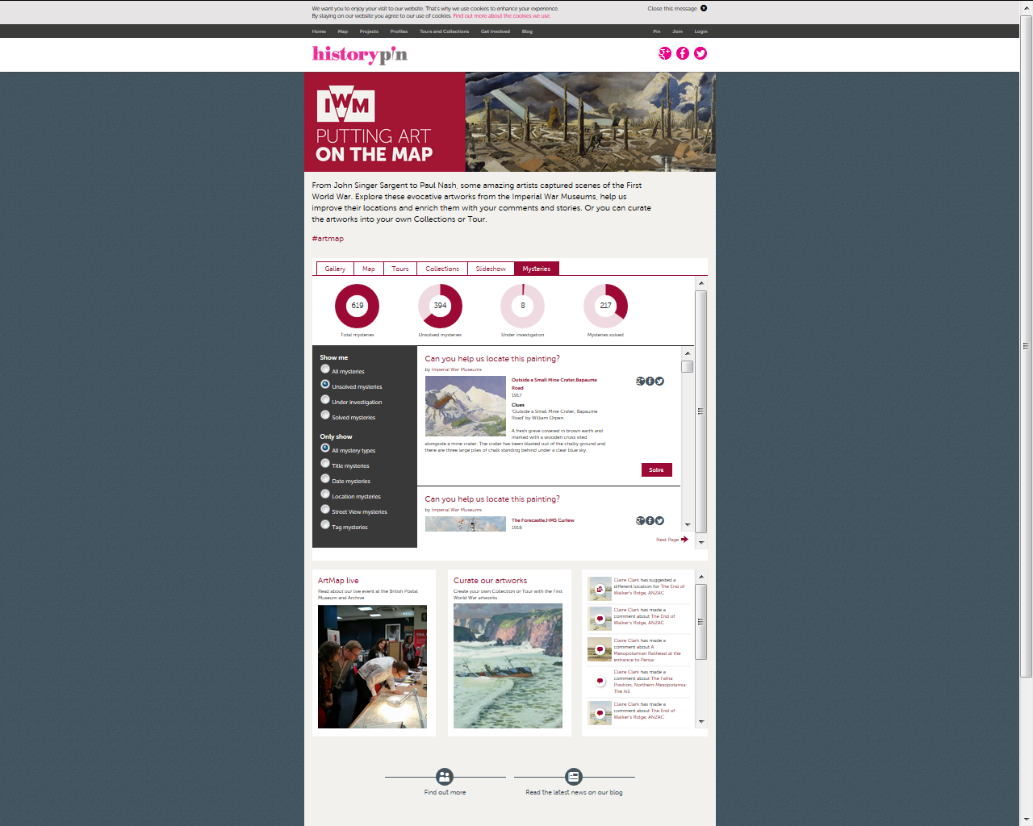
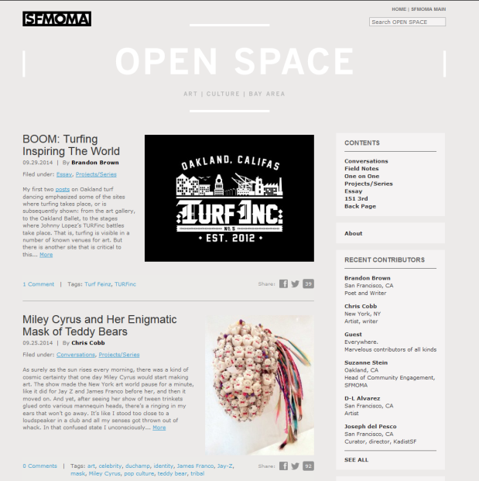
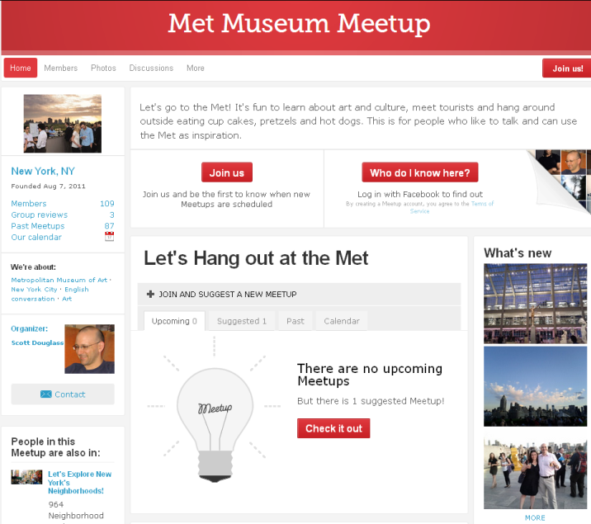
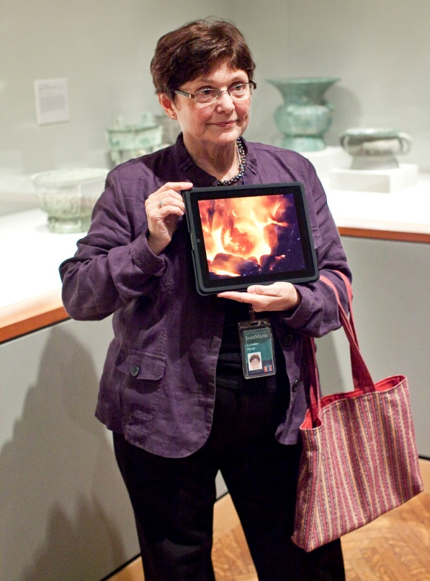
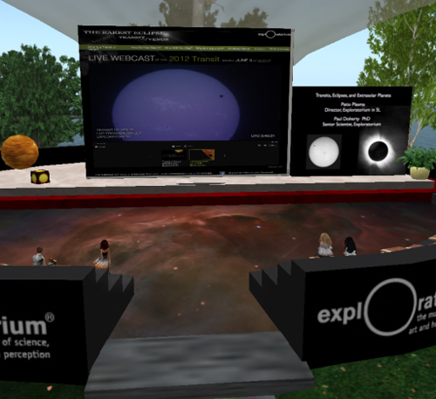
PHYSICAL
VIRTUAL
Museums & Digital Technology: Idealism & Pragmatism. Susana Smith Bautista, Ph.D.

Slide 19
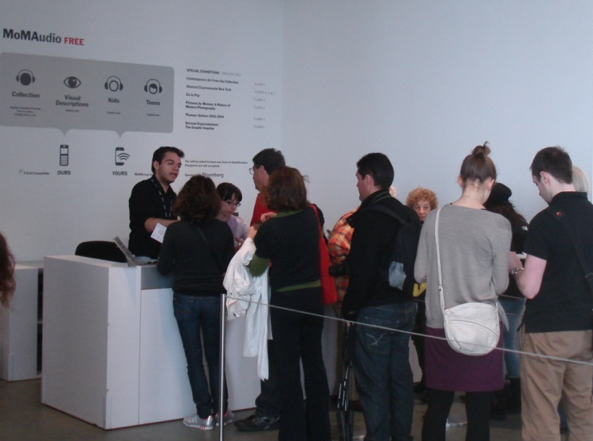
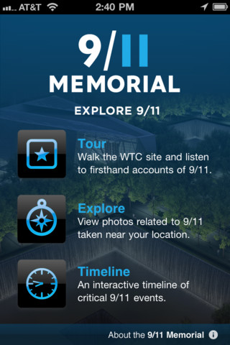
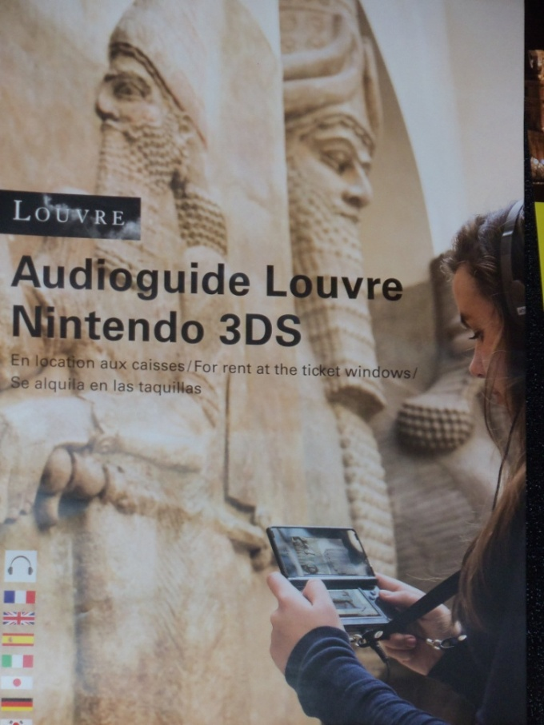
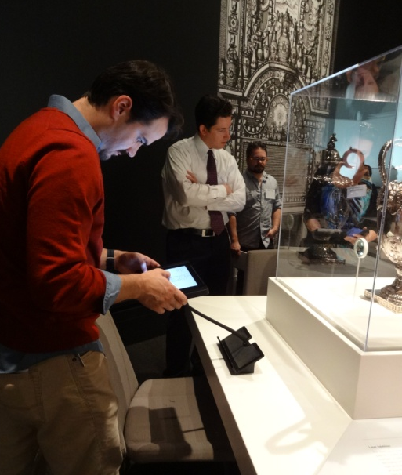
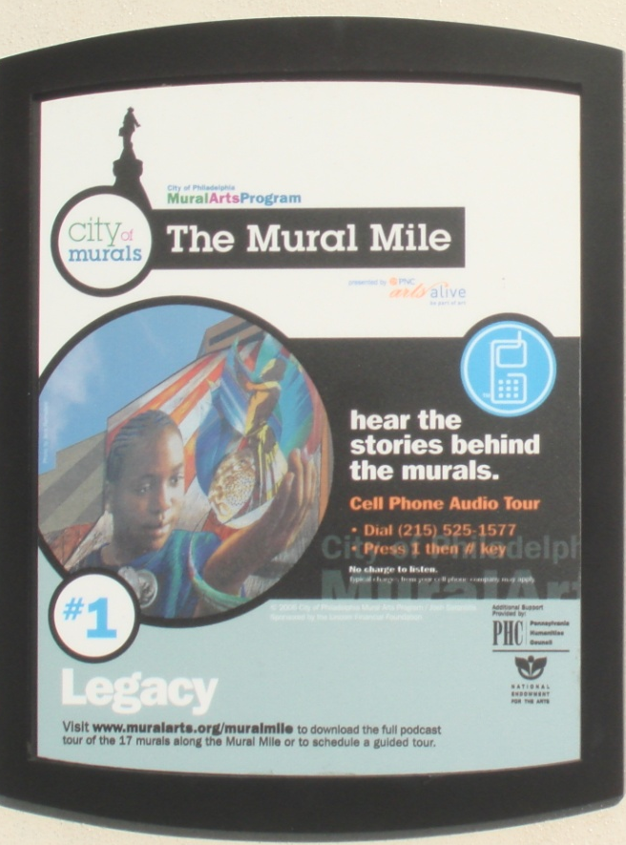
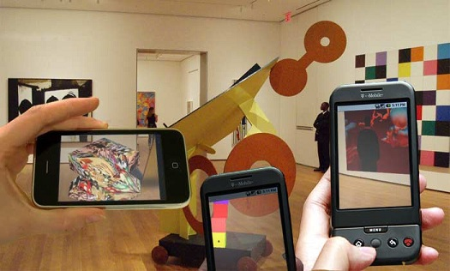
FIXED
MOBILE
Museums & Digital Technology: Idealism & Pragmatism. Susana Smith Bautista, Ph.D.

Slide 20
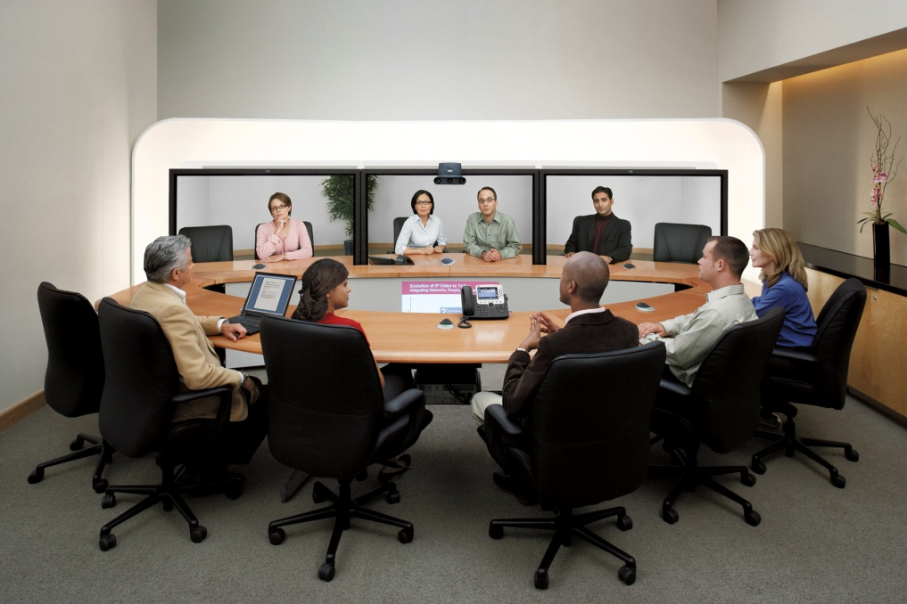
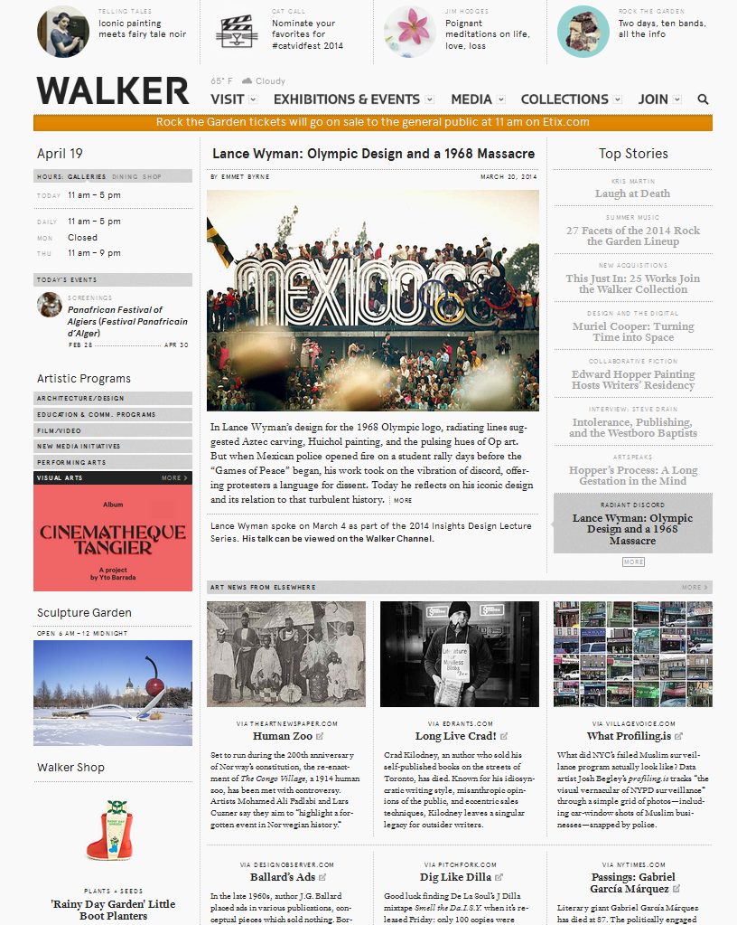
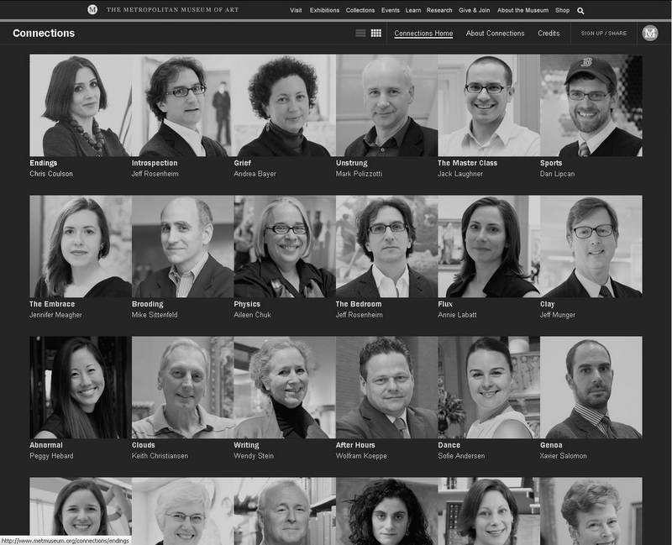
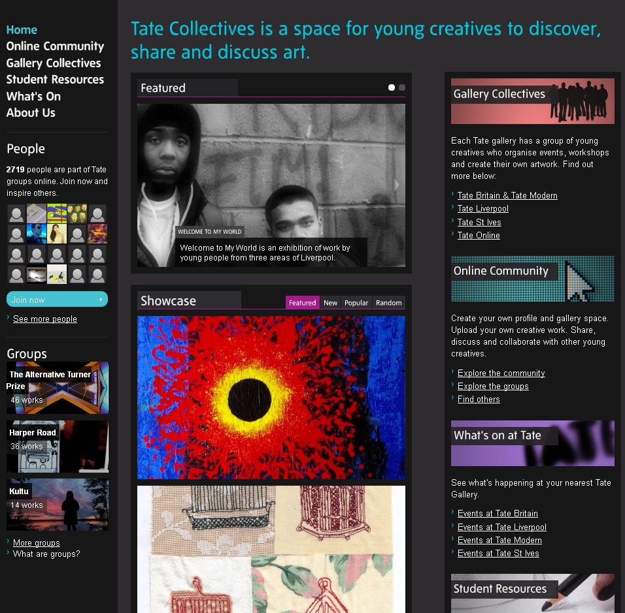
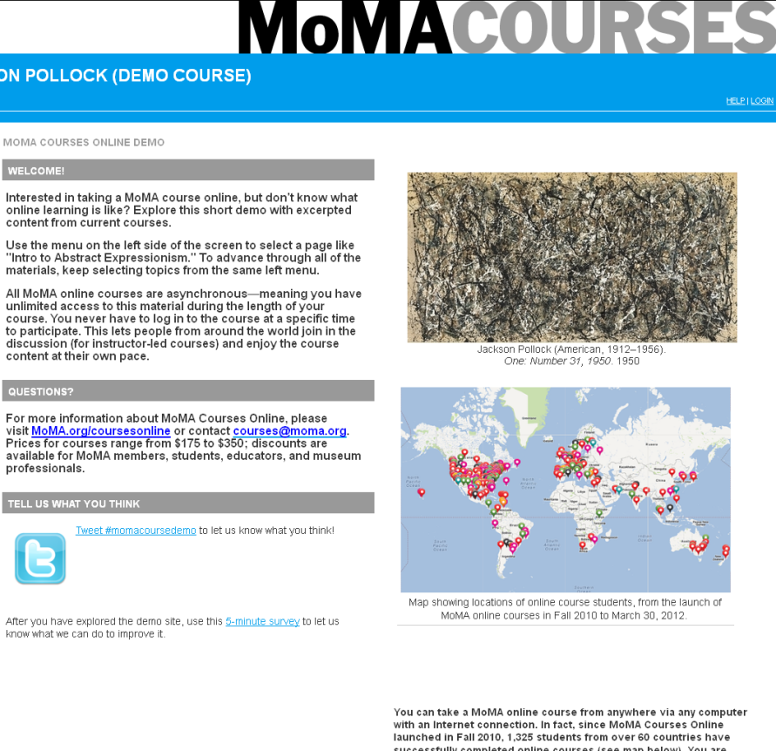
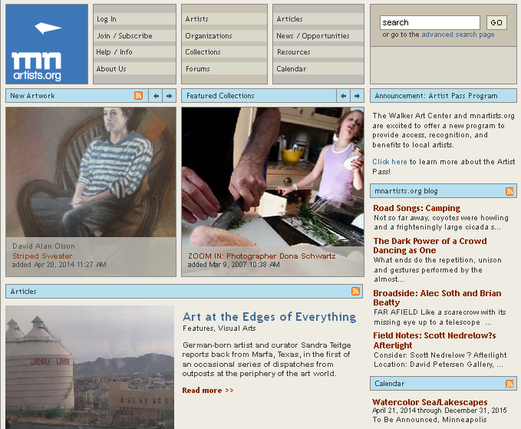
www.redgage.com
LOCAL
GLOBAL
Museums & Digital Technology: Idealism & Pragmatism. Susana Smith Bautista, Ph.D.

Slide 21
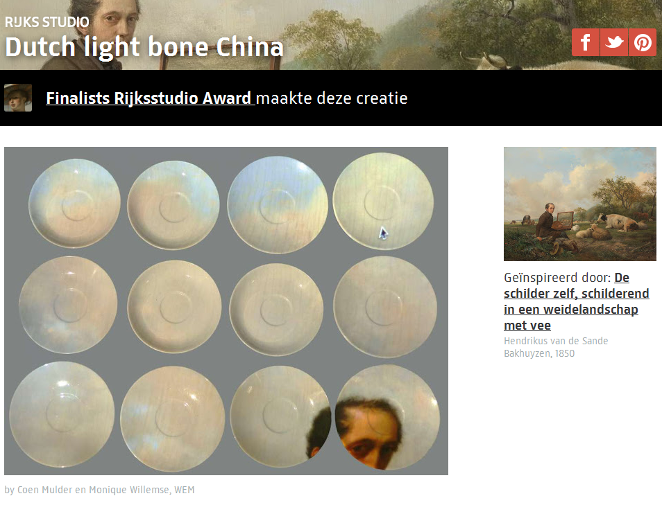

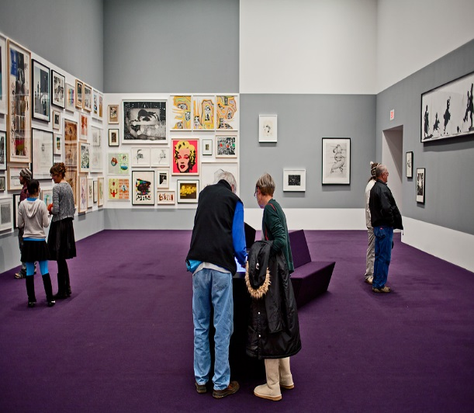
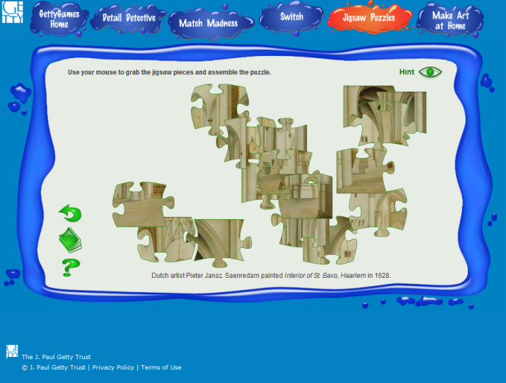
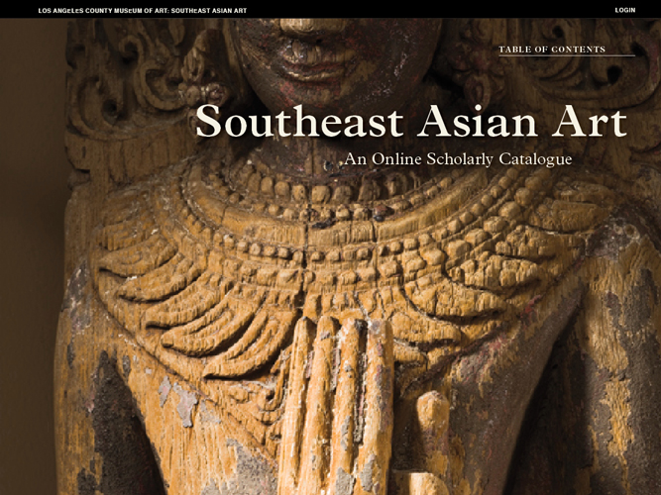
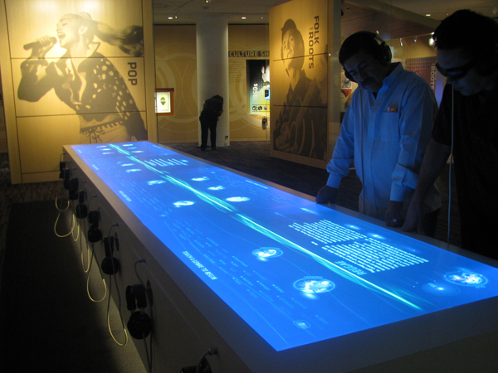
OPEN
CLOSED
Museums & Digital Technology: Idealism & Pragmatism. Susana Smith Bautista, Ph.D.

Slide 22
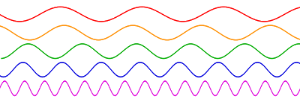

http://quibb.blogspot.com
www.zastavki.com
Museums & Digital Technology: Idealism & Pragmatism. Susana Smith Bautista, Ph.D.

Slide 23
technology does not determine culture…
culture determines technology.
Museums & Digital Technology: Idealism & Pragmatism. Susana Smith Bautista, Ph.D.

Slide 24
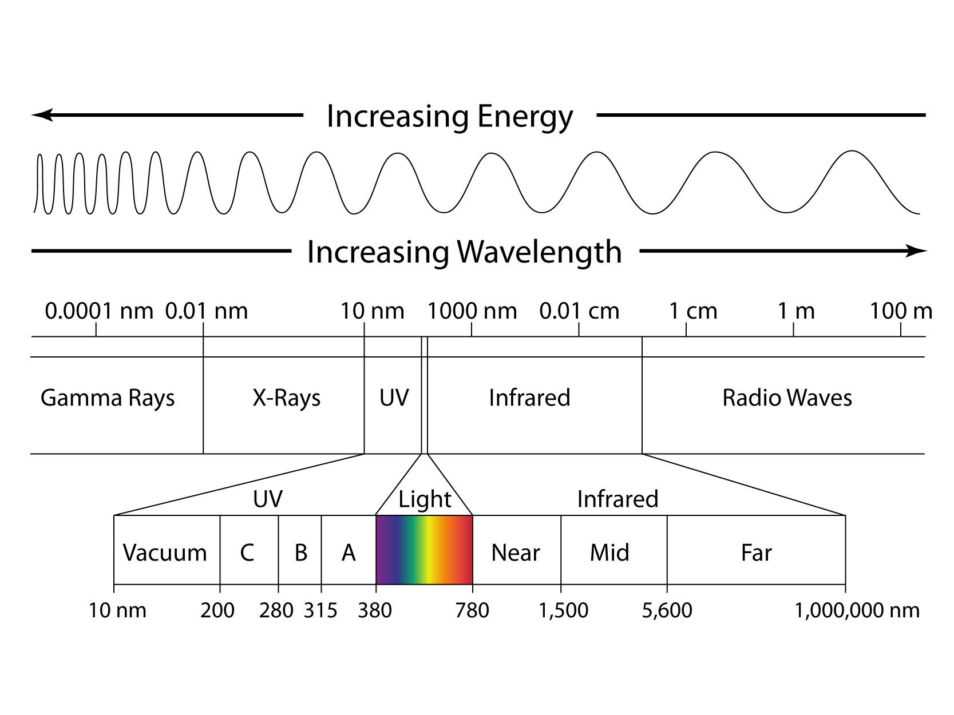
MUSEUMS AND DIGITAL TECHNOLOGY
IDEALISM
PRAGMATISM
Where is your museum experience?
Susana Smith Bautista, Ph.D.
November 6, 2014
ssbautista@yahoo.com

