Slide 1
Social Work Beyond Talk Interventions:
Artfluence As Strategy And Outcome
Presentation for the Symposium on Social Work and the Arts
The Role of Museums in Social Work
Susana Smith Bautista, Ph.D.
Deputy Director, USC Pacific Asia Museum

Slide 2
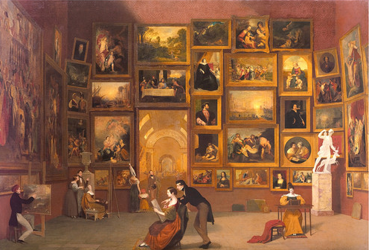
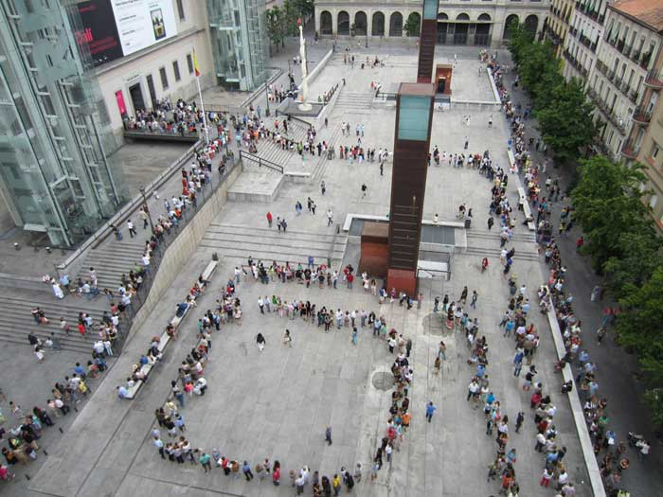
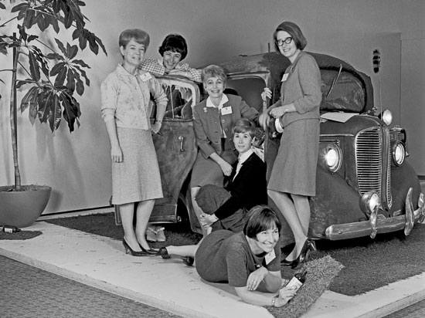
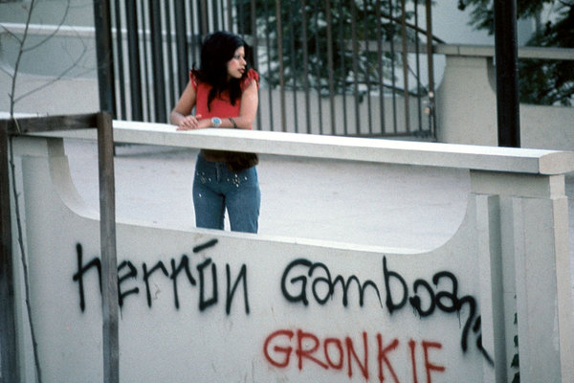
The History of Museums as Social Organizations

Slide 3
U.S. museums spend more than $2 billion a year on education.
The typical museum devotes 75% of its education budget to K-12 students.
Museums receive approximately 55 million visits each year from students in school groups.
Museums provide more than 18 million instructional hours annually for guided tours to students, school outreach through traveling exhibits, and professional development for teachers.
WHY MUSEUMS?
The American Alliance of Museums estimates there are 17,500 museums in the United States.
A 1999 study reported that American museums average a total of 865 million visits a year, or 2.3 million visits a day.
In 2006, AAM found the median annual attendance for art museums is 59,822.
“ A museum is a non-profit, permanent institution in the service of society and its development, open to the public, which acquires, conserves, researches, communicates and exhibits the tangible and intangible heritage of humanity and its environment for the purposes of education, study and enjoyment. ”
- International Council of Museums, 2007

Slide 4
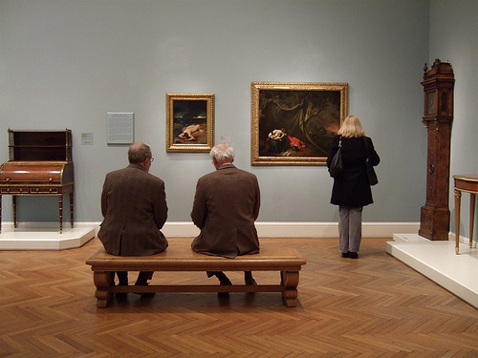
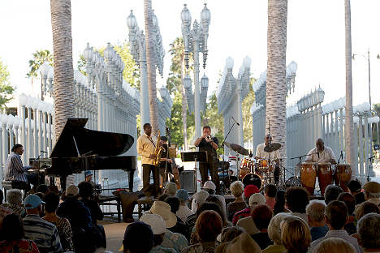
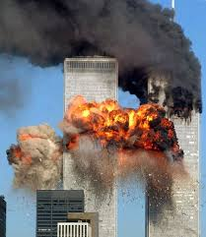
“Museums are also expanding their ability to link people together and foster interaction through networking interventions… The museum environment is frequently key to such interventions because it is for many people a relatively safe, trustworthy, respected, and even esteemed environment in which people come together and engage with objects that stimulate social interaction.”
- Lois Silverman, The Social Work of Museums (2010)
“Hospitals…they’re around to fix the body.
We’re here to fix the soul.”
– Philippe de Montebello, Director of the Metropolitan Museum of Art (2001)

Slide 5
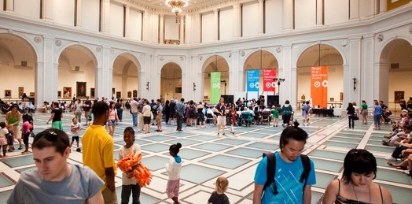
Common activities
Common goals
Common humanity
Common spaces
Creating Social Capital

Slide 6
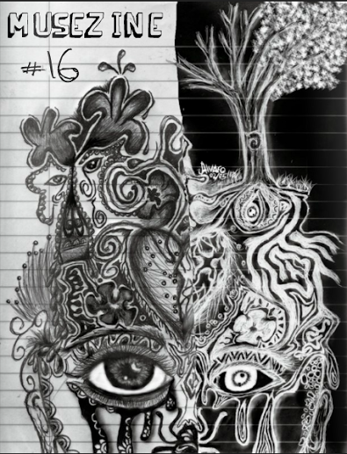
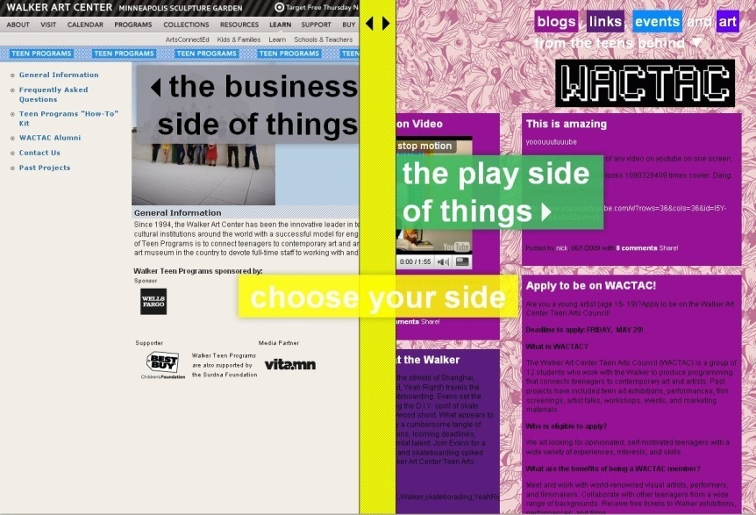
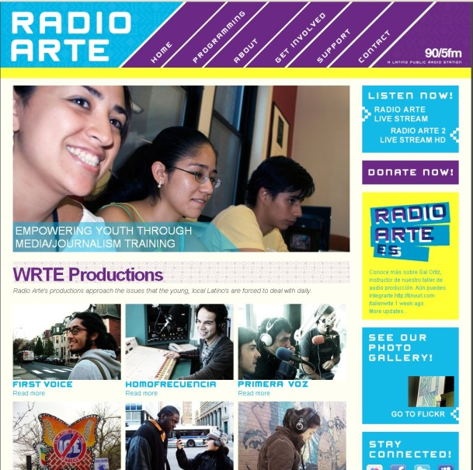
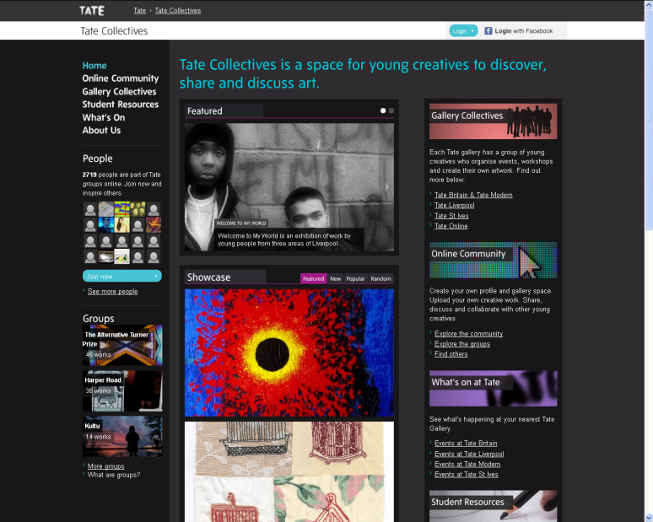
Accessing Youth through the
Arts & Digital Media
Participatory
Interactive
Creative
Social
Fun
Didactic

Slide 7
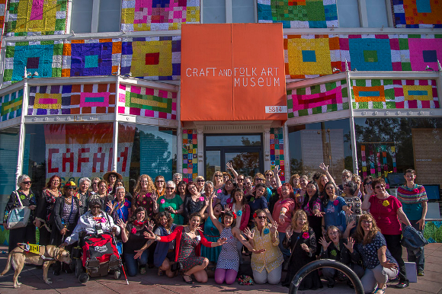
Empowering Visitors in a more Democratic Museum
Participatory practices
User-generated content
Crowd-curated exhibitions
Social media-supported affinity groups
Open Content
“The best way to think about the changing relations between museums and communities is to think about how the audience, a passive entity, becomes the community, an active agent”
– Ivan Karp (1992)
Today in the digital age, museums are no longer working for their community but with their community.
“We believe in the strength of our masterpieces.
We also believe that they belong to everyone, and that there is an artist in all of us.” – Rijksmuseum, Netherlands

Slide 8
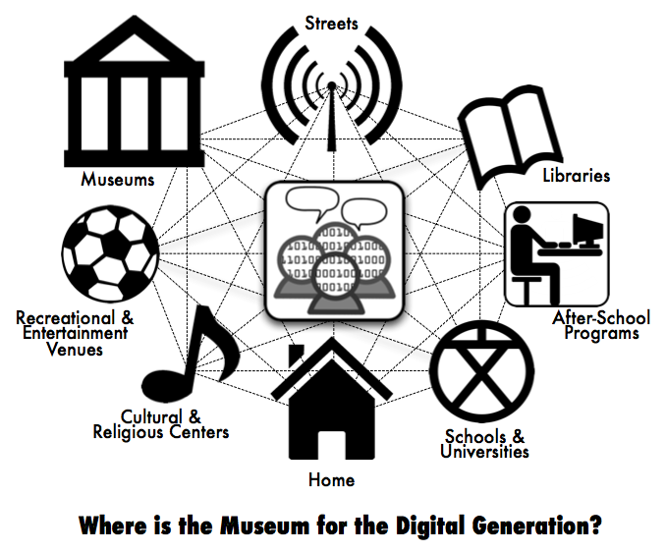
The Distributed Museum
Musée imaginaire (museum without walls) – André Malraux (1967)
Deterritorialized hyperspace networks – Paul Virilio (1997)

Slide 9
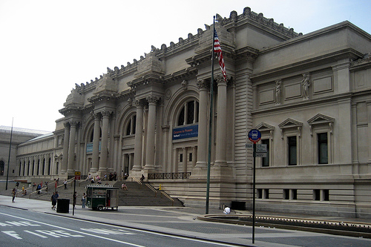
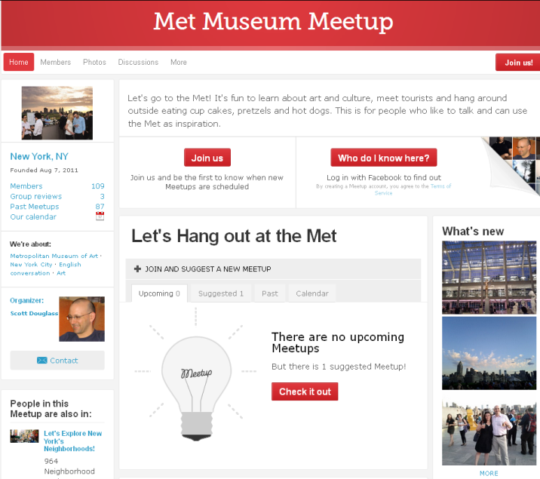
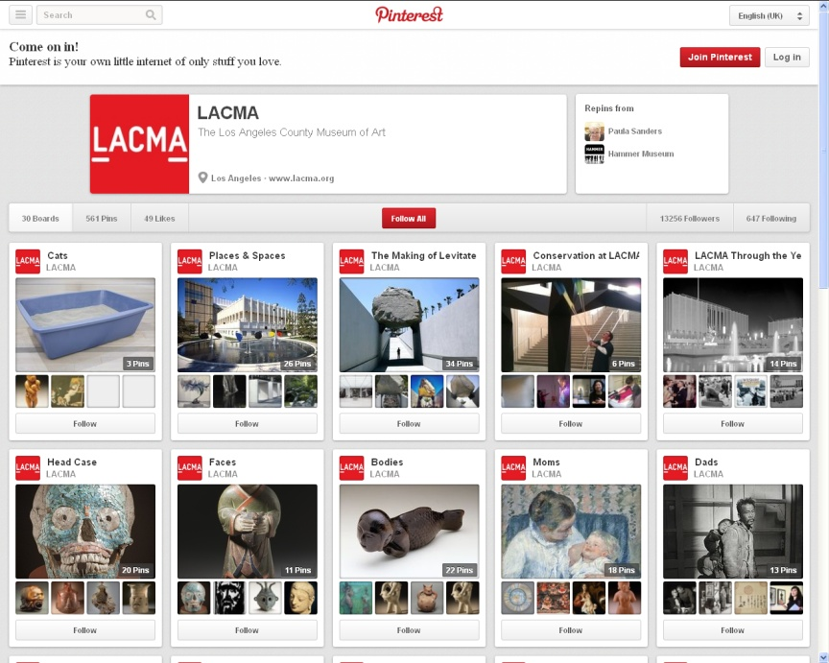
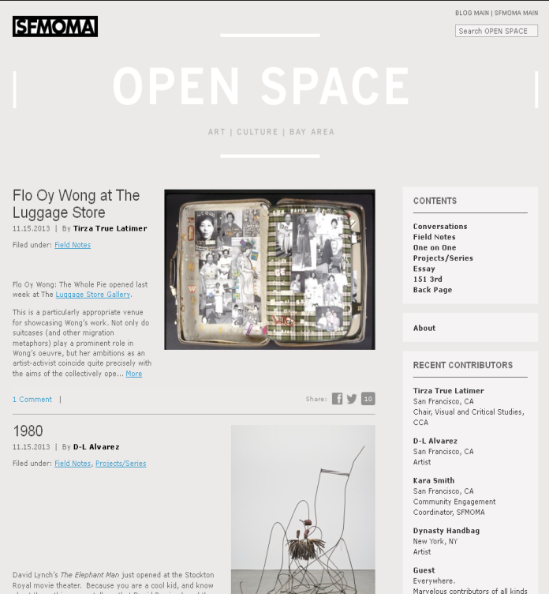
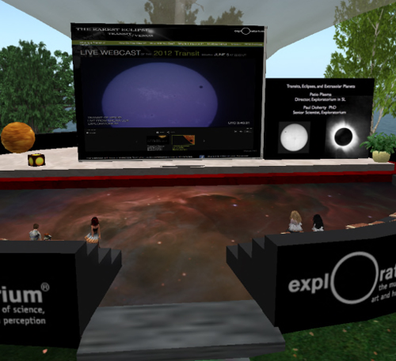
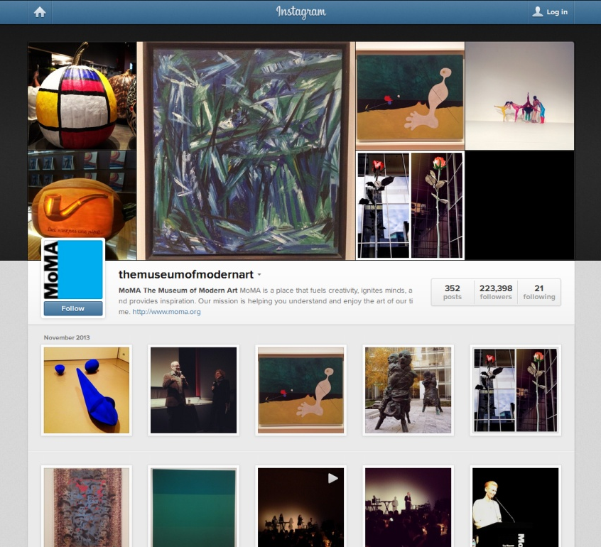
MUSEUM SPACES

Slide 10
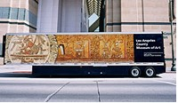
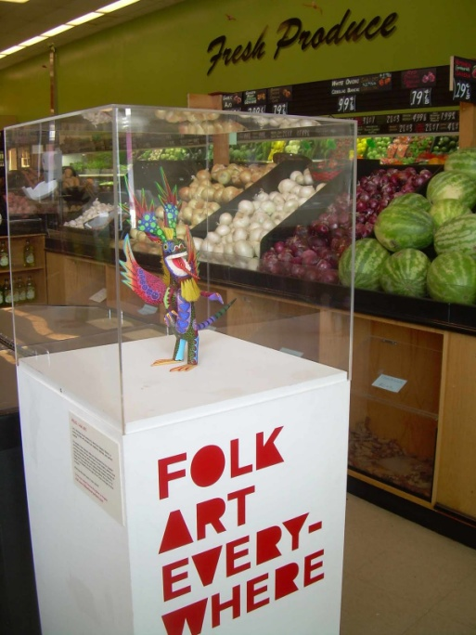
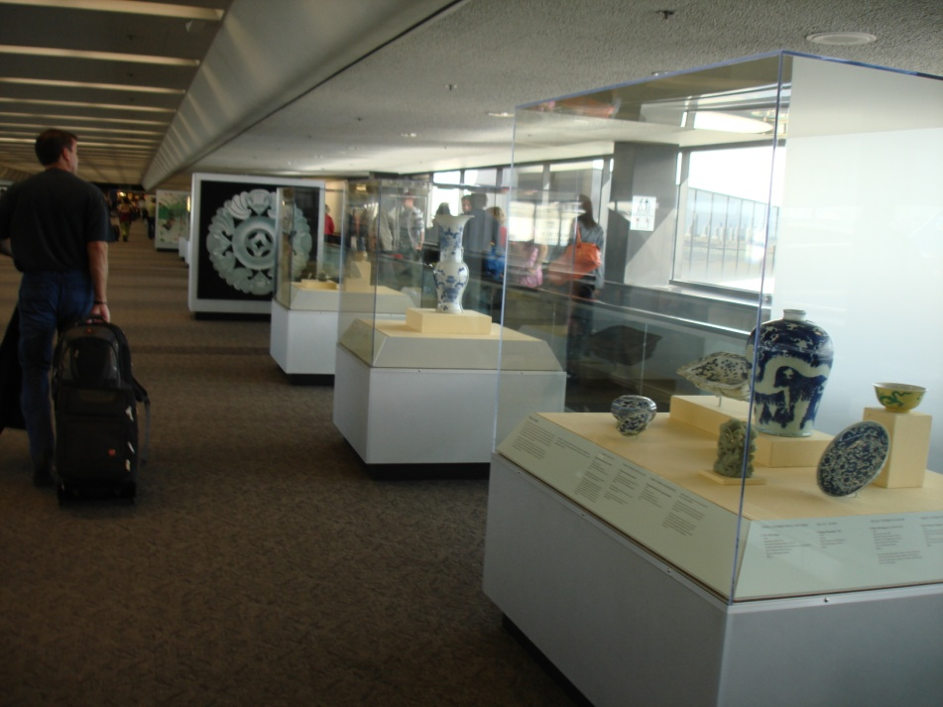
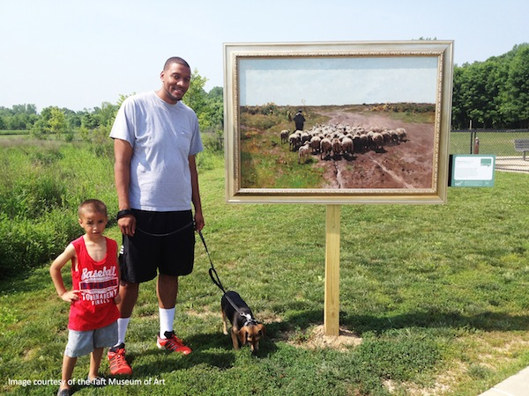
Museums and their Communities
“Since visitors do not make meaning from museums solely within the four walls of the institution, effective digital media experiences require situating the experience within the broader context of the lives, the community, and the society in which visitors live and interact.”
- John Falk & Lynn Dierking (2008)

Slide 11
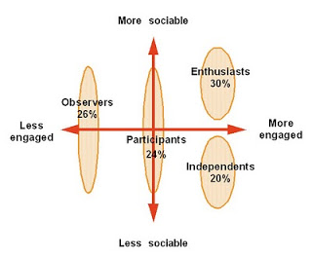
Museum Educators
&
Social Work
Human Services
Community Outreach
Visitor Studies
“Museums matter only to the extent that they are perceived to provide the communities they serve with something of value beyond their own mere existence… The museum that does not prove an outcome to its community is a socially irresponsible as the business that fails to show a profit. It wastes society’s resources.”
- Stephen E. Weil, Making Museums Matter (2002)

Slide 12
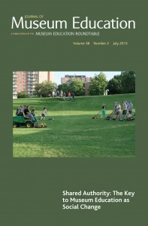
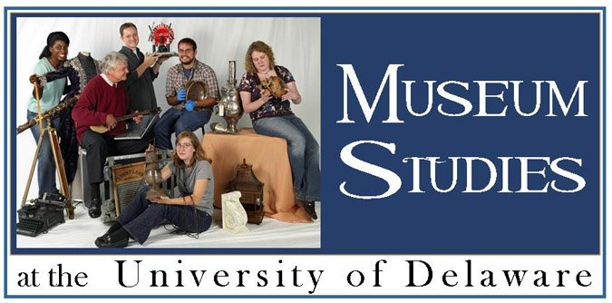
Resources for Collaboration

Slide 13
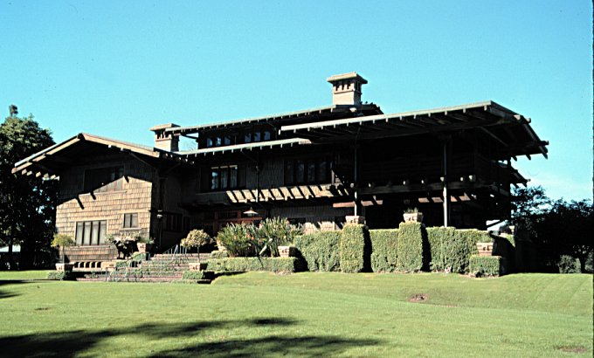
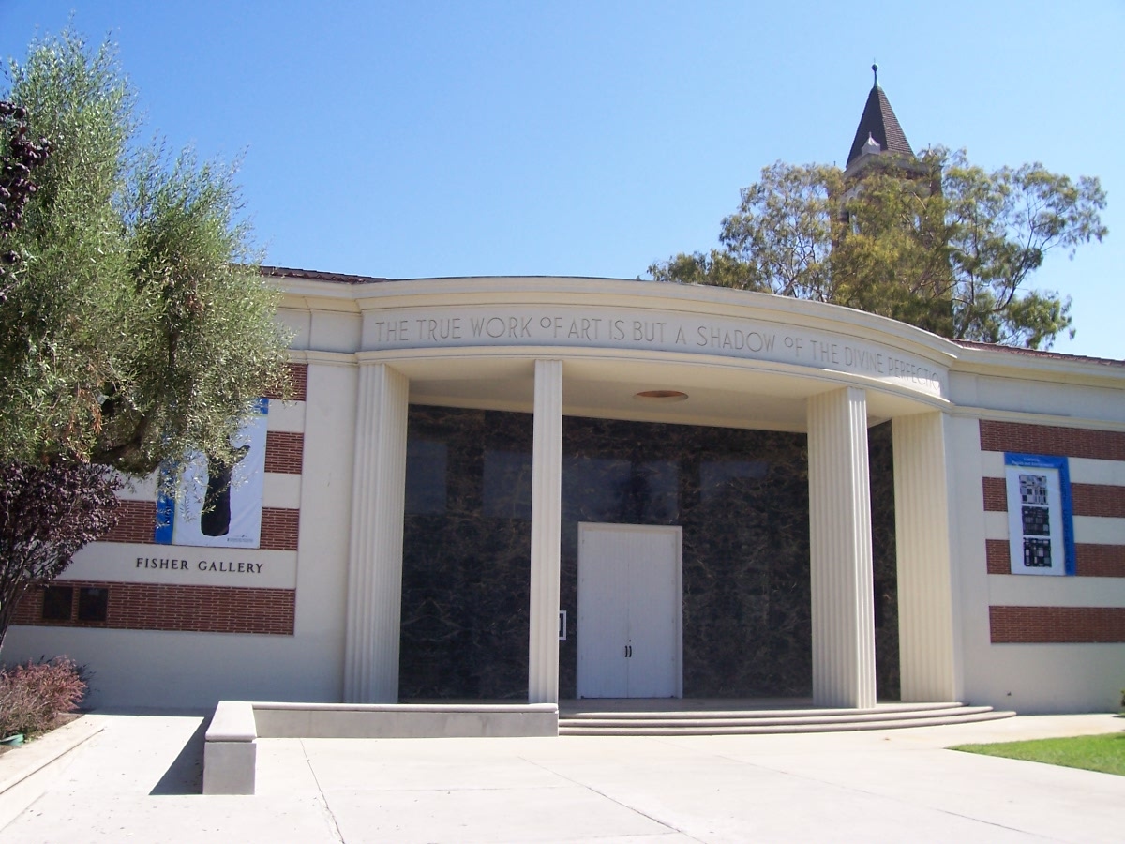
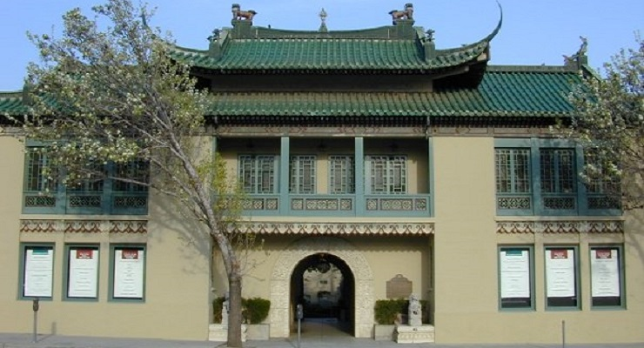
University & Museum
Partnerships
USC Fisher Museum of Art
The Gamble House
USC Pacific Asia Museum

